Slide 1
Grand Canal Greenway Phase 2
Project Update April 2026

Slide 2
Updates since May 2024
Sallins Link;
  A request for tender was issued to contractors for quotations to complete the ‘Sallins Link’ section in Sallins Village.
  These works are the works that were approved by Part VIII in May of 2024.
  Works will commence on site in the coming weeks following the appointment of a preferred contractor.
  Works include the removal of the existing vehicular ramp from the R407 to Canal View to be replaced by a new precast construction pedestrian ramp, installation of a new controlled crossing on the R407 to link the towpath from East to West and a link towpath from the new ramp to the bridge on the east of Sallins. This project will include considerable utility coordination, Traffic Management and Stakeholder Engagement.
Final design is underway on the remainder of the project with a tender pack completed for the sensitive section from the 20th Lock to Clonkeen (Offaly Border) these works will be completed by Waterways Ireland dependent on weather conditions and resource availability.
It is anticipated to issue another circa 6km section of towpath and junction works for tender also by mid-year 2026. Which will be constructed later this year 2026.

Slide 3
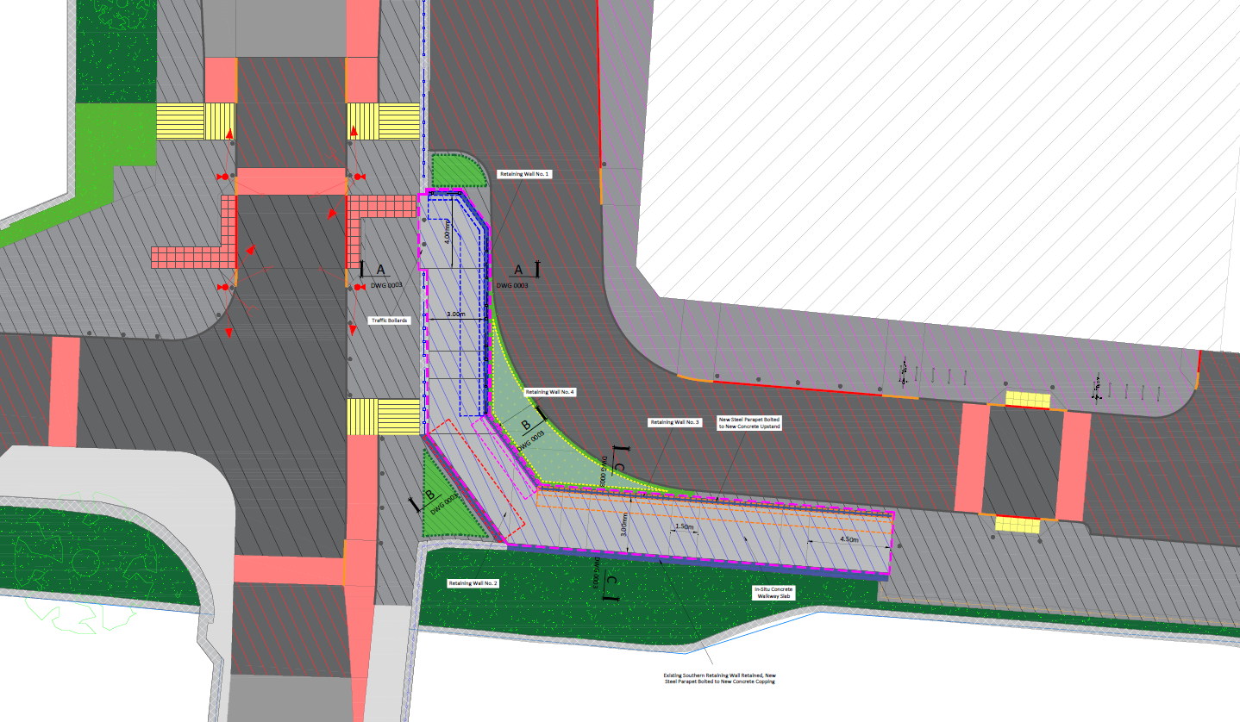
Sallins
Works Proposal Layout

